Slide 1

Session 1
Introduction: Preliminary Training for Drug Evaluation and Classification Program

Slide 2
Session Learning Objectives
  State goal and objectives of the course
  Define the term “drug” as it is used in the course
  Name the seven categories of drugs and give at least one example of each category

Slide 3

Housekeeping
  Paperwork
  Mandatory attendance
  Breaks
  Facility
  Interruptions

Slide 4

Participant Introductions
  Name
  Agency
  Affiliation
  Experience

Slide 5
Introduction
Goal: To prepare the participants to succeed in the 7-Day Drug Recognition Expert School

Slide 6
Course Learning Objectives
  Define “Drug”
  Name the seven drug categories
  Identify the twelve steps in the DRE drug influence evaluation
  Administer and interpret the psychophysical tests used by DREs during the drug influence evaluation

Slide 7
Course Learning Objectives
  List, check, and measure vital signs utilized in DRE examinations
  List major signs and symptoms of each drug category
  Conduct eye examinations that are part of the drug influence evaluation
  Describe history and physiology of alcohol as a drug

Slide 8


Slide 9
Drug Definition
  Merriam-Webster.com dictionary
  Random House College Dictionary
  Medical Dictionary For the Non-Professional
  Los Angeles Police Department Drug Recognition Training
  LAPD

Slide 10
What is a “Drug”?
“Any substance that, when taken into the human body, can impair the ability of the person to operate a vehicle safely.”

Slide 11
What are the seven categories of drugs?

Slide 12
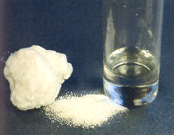
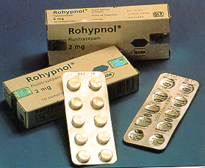
Central Nervous System Depressants
Alcohol
Barbiturates
Valium
Chloral Hydrate

Slide 13
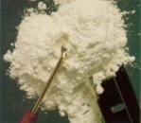
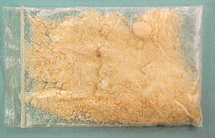
Central Nervous System Stimulants
  Cocaine
  Amphetamines
  Methamphetamine

Slide 14
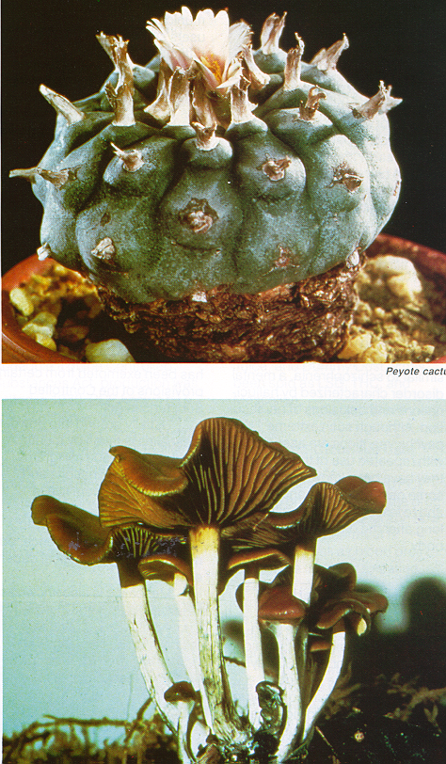
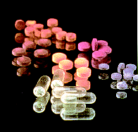
Hallucinogens
  LSD
  Peyote
  Ecstasy

Slide 15
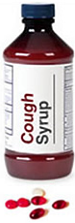
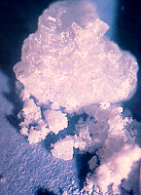
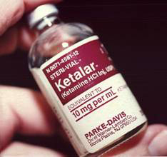
Dissociative Anesthetics
  Phencyclidine (PCP)
  Ketamine
  Dextromethorphan (DXM)

Slide 16
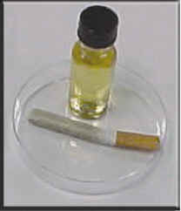

Dissociative Anesthetics – PCP

Slide 17
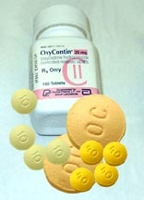
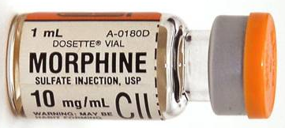
Narcotic Analgesics
  Heroin
  Morphine
  Codeine

Slide 18
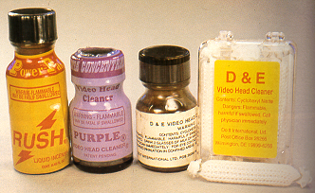
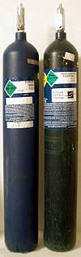
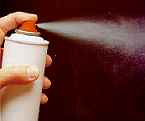
Inhalants
  Paint
  Various glues
  Nitrous Oxide

Slide 19
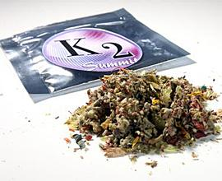
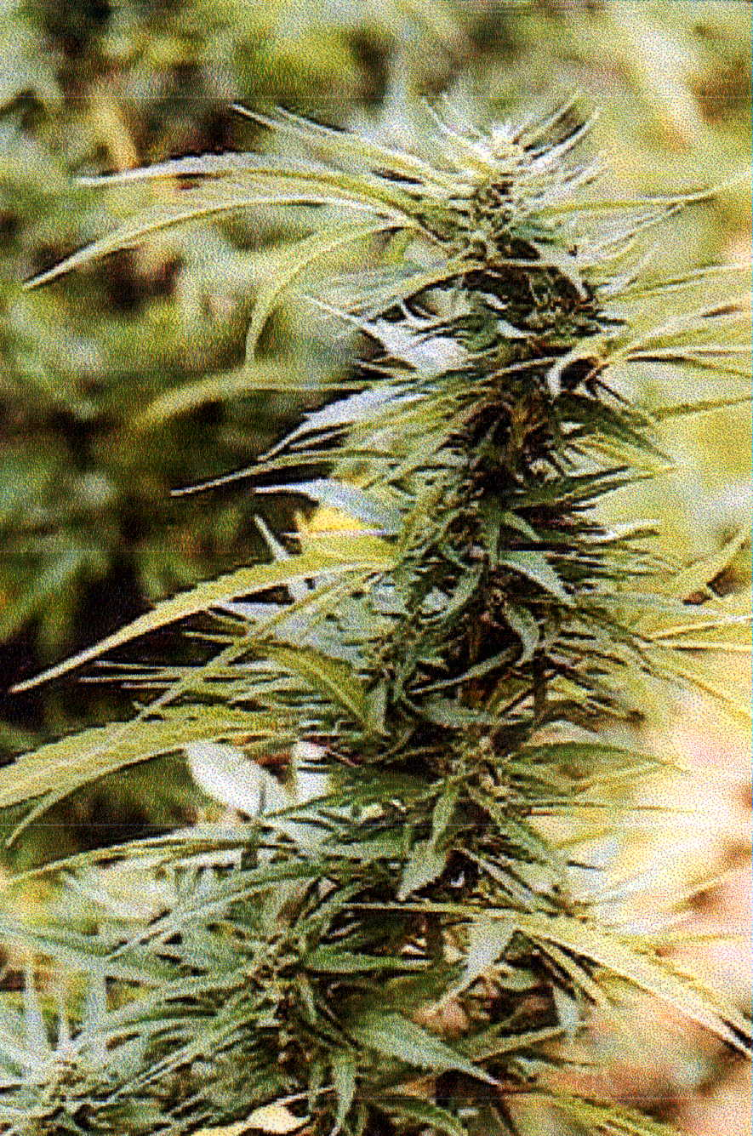
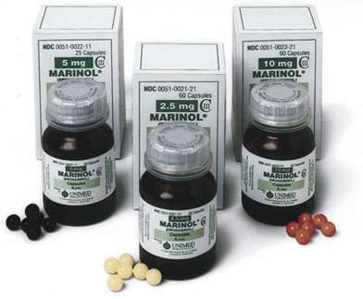
Cannabis
  Marijuana
  Hashish
  Marinol
  K-2 / Spice

Slide 20
37.3 million
All illicit drugs users
32.8 million
also use Marijuana

Slide 21
Misusers of Psychotherapeutic Drugs
(In Millions)

Slide 22
Frequency of Polycategory Use
  Under the combined influence of two or more different drug categories
  Approximately 1/3 of all toxicology results indicate two or more drug categories

Slide 23
Questions?

